Slide 1
Econ 106 Lecture 5 Fall 2024
slides adapted from https://jhudatascience.org/tidyversecourse/dataviz.html#about-this-course-3

Slide 2
Reminders
Lab 1 is due Sunday 11:59pm
Poll everywhere scores are in the canvas gradebook (full credit if >50% correct)
https://pollev.com/vsovero

Slide 3
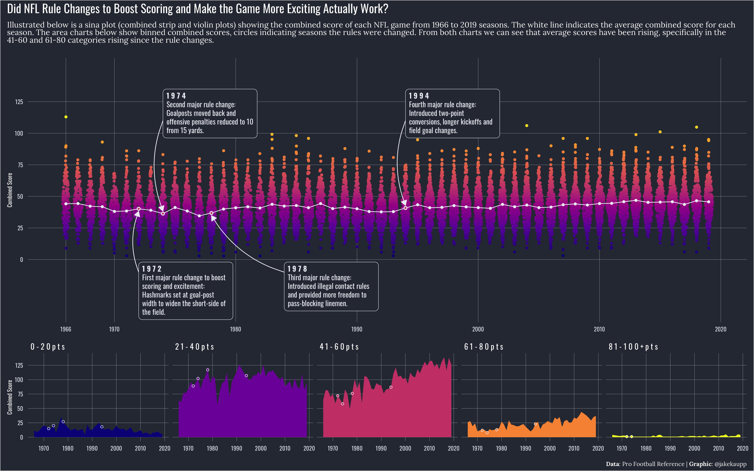
#tidytuesday
Football is happening now, right?
https://x.com/jakekaupp/status/1226556813476270080?s=20

Slide 4
Outline
Visualization Background
Introduction to ggplot2
Basic elements (data, aesthetics, geoms)
color as information
Notes:
In brief, we’ll
1. Introduce the R programming language and the RStudio interface
2. Discuss how operators and functions work
3. Investigate the structure of data frames

Slide 5
“A picture is worth a thousand words"
Replace (or complement) ‘typical’ tables of data or statistical results with figures that are more compelling and accessible.
Two main advantages of data visualization:
Facilitates comparisons
Helps identify trends

Slide 6

Why ggplot2?
Reproducibility
Part of the tidyverse
Pretty by default
Customizable
http://varianceexplained.org/r/why-I-use-ggplot2/
Notes:
So why use ggplot2?
· For one, using a scripting language to make graphs makes your research reproducible. You can hand your code and your data to anyone and they can reproduce your results if they can install R. But this is true of all graphics packages in R
· However ggplot2, it’s part of the tidyverse, which is a set of tools specifically designed for working with data. Because it was designed in concert with dplyr, commands from dplyr can be piped into to ggplot to create a seamless workflow.
· Finally, ggplot2 graphs look good by default, which takes a lot of work in the base R graphics package. And if you don’t like the default look, it’s easy to create and apply custom themes. This last point is a bit contentious in the R community. For a nuanced discussion, see the blog post linked to on this slide.

Slide 7
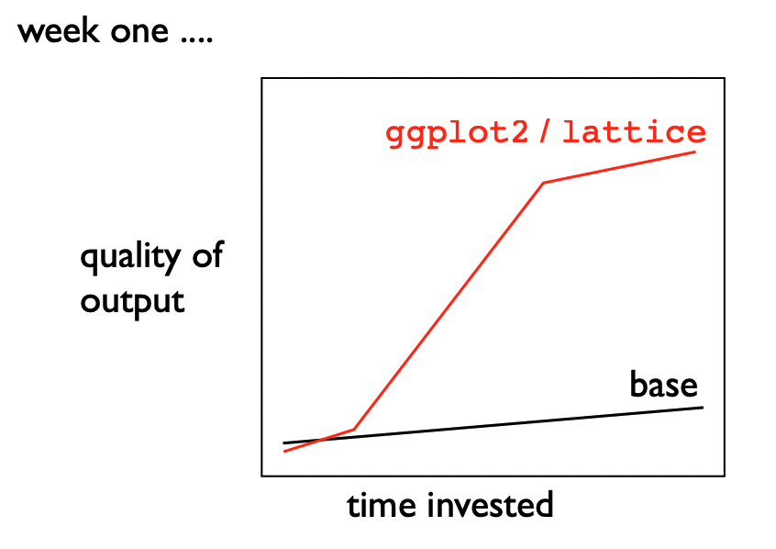
But first, some truth about ggplot2
Full disclosure: it’s not the easiest to get the hang of
Simple visualizations are easier using base R

Slide 8
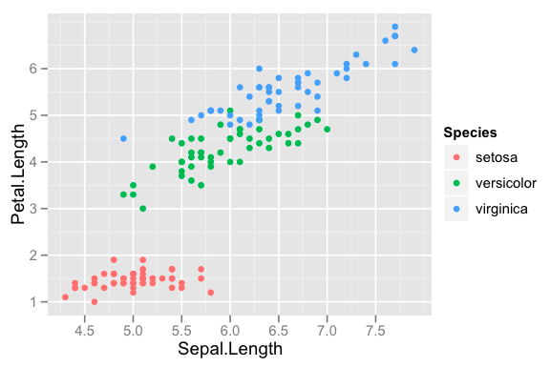
Basic Elements of a Data Visualization
Data: the data you want to plot
Layout: mapping variables on the plot
Data display: how you want the data to be visualized (points, lines, bars, etc.)
Notes:
Once the data are loaded, we’ll be using the ggplot2 package to plot these data. All ggplots contain 3 basic elements:
1. Data in the form of a tibble
2. Aesthetics that determine how the plot looks and
3. Geoms, which specify how the data should be plotted. For example, will the data be represented by points, lines, bars, etc.

Slide 9
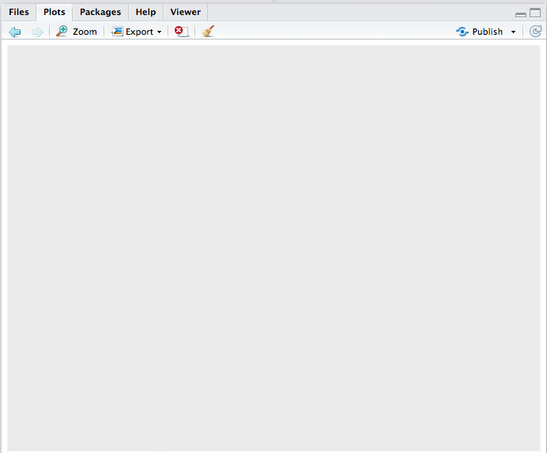
1. Specify data
ggplot(data = diamonds)
ggplot(): Creates a plot object
data specifies what data table you will use
Output: blank plot
Notes:
First, let’s look at the ggplot function. If data is the only specified argument, the function will still initialize the plot window, but it won’t plot anything because you haven’t specified what to plot.

Slide 10
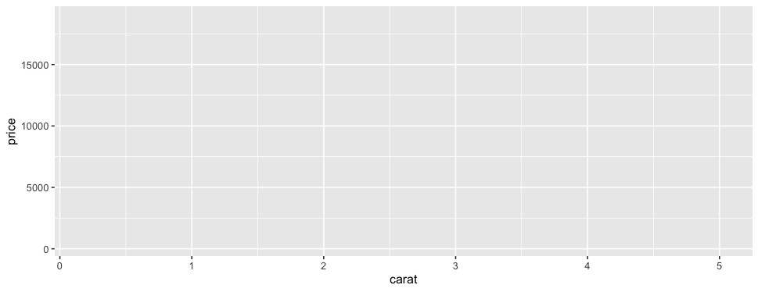
2. Specify Layout
ggplot(data = diamonds,
mapping = aes(x = carat, y = price))
mapping argument specifies what should go on the x and y axes
x = x axis variable
y = y axis variable
aes() function is required whenever you reference specific variables in your data
Output: plot with axes, no data
Notes:
If you add and the aesthetics argument which specifies what should go on the x and y axes, it draws the axes. In this case, we have weight on the x axis and hindfoot length on the y axis.

Slide 11
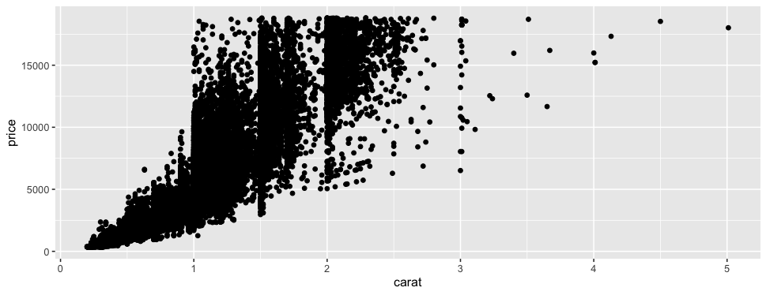
3. Specify Data Display
ggplot(data = diamonds,
mapping = aes(x = carat, y = price)) +
geom_point()
requires:
+ operator
geom_point()
Output: scatterplot
Notes:
However, the data are not plotted on the graph until you specify the geom. Make sure to add the + operator at the end of the ggplot statement. In this case, we’ll be plotting the data as points using geom_point()
Let’s see how this works
Demo 2:
· gray plot area
ggplot(data = surveys_complete)
· Axes drawn
ggplot(data = surveys_complete,
aes(x = weight,
y = hindfoot_length))
Plot ggplot(data = surveys_complete, aes(x = weight,
– axes drawn
· scatter plot of hindfoot length vs weight
ggplot(data = surveys_complete,
aes(x = weight,
y = hindfoot_length)) +
geom_point()

Slide 12
ggplot2 functions
ggplot(): creates a ggplot object
aes() function is required whenever you reference specific variables in your data
geom_XXX(): draws points/lines etc.
+: adds components to plot
Modular structure
Notes:
The ggplot2 package contains a set of functions to implement these concepts:
1. The ggplot() function initializes the ggplot object.
2. The aes() function draws the axes and other visual features. It used as an argument to the ggplot function
3. The set of geom functions like geom_points() draws the data on the plot
4. Finally, the + operator allows you to add components to the plot in a modular fashion.

Slide 13
Scatter Plot
https://pollev.com/vsovero
ggplot(data = diamonds,
mapping = aes(x = carat, y = price)) +
geom_point()

Slide 14
Data Example
We are going to work with the gender gap data:
jobs_gender <- read_csv("https://raw.githubusercontent.com/rfordatascience/tidytuesday/master/data/2019/2019-03-05/jobs_gender.csv")

Slide 15
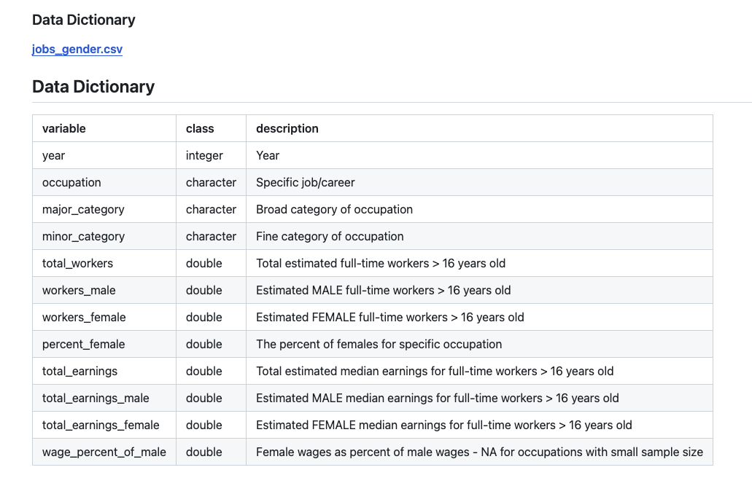
tidytuesday data

Slide 16
Exercise
Create a scatter plot with total_earnings on the x-axis and wage_percent_of_male on the y-axis

Slide 17
Adjusting Plot Settings
color: color of 1-d objects
fill: fill color of 2-d objects
linetype: how lines should be drawn (solid, dashed, dotted, etc.)
shape: shape of markers in scatter plots
size: how large objects appear
alpha: transparency of objects (value between 0 and 1)

Slide 18
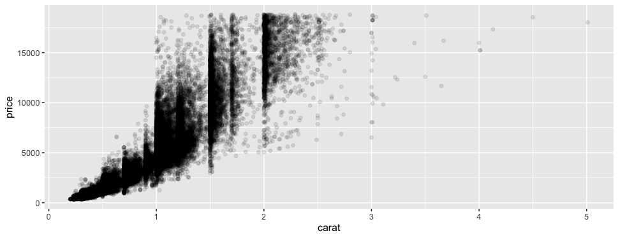
Transparency
ggplot(data = diamonds,
mapping= aes(x = carat, y =price)) +
geom_point(alpha = 0.1)
Add argument to geom_point()
Reduce transparency of points
Input: alpha = 0.1
1/10 opacity
Range: 0-1
Notes:
Now that we’ve drawn basic scatterplot, let’s customize it.
· One common customization is altering the transparency of the points
· This modification allows you to see where the points are the most dense
· We can do this by using the alpha argument in the geom_point function
Demo 3:
· Copy and paste Demo 1
· Add alpha = 0.1 as an argument to geom_point

Slide 19
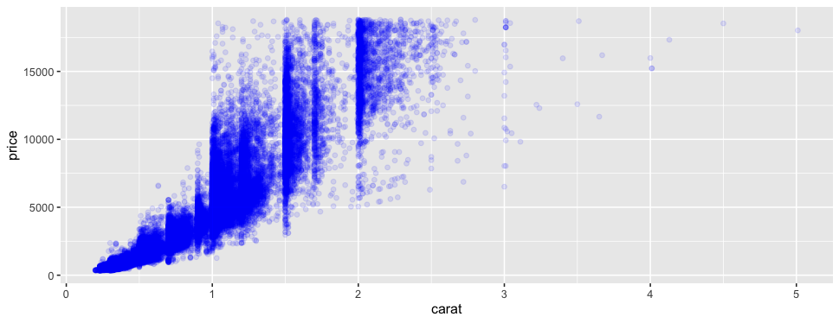
Color
https://pollev.com/vsovero
ggplot(data = diamonds,
mapping= aes(x = carat, y = price))+
geom_point(alpha = 0.1,
color = "blue")
Change point colors to blue
Input: color argument
Output: blue points
Color reference chart: http://sape.inf.usi.ch/quick-reference/ggplot2/colour
Notes:
Now let’s add some color. We can turn the points blue by adding the color = “blue” argument to geom_point. For a full list of colors, see the color reference chart linked on this slide.
Demo 4:
· Copy and Paste Demo 2
· Add color = blue as an argument to geom_point

Slide 20
Exercise: scatter plots and color
Your boss requires that all scatter plots use triangle shapes and the cornflower blue color (“cyan”). Adjust your scatter plot of total_earnings and wage_percent_of_male accordingly.

Slide 21
Dplyr and ggplot
Oftentimes you will use dplyr to create a new data frame, then plot the results using ggplot
Remember to put in the name of the new data frame in your ggplot()
very_good_cut<-diamonds%>%
filter(cut== "Very Good")
ggplot(data = very_good_cut,
mapping= aes(x = carat, y = price))+
geom_point(alpha = 0.1,
color = "blue")

Slide 22
Dplyr and ggplot
Oftentimes you will use dplyr to create a new data frame, then plot the results using ggplot
You can also “pipe” in the results directly into ggplot (removing the data argument inside ggplot())
diamonds%>%
filter(cut== "Very Good") %>%
ggplot(mapping= aes(x = carat, y = price))+
geom_point(alpha = 0.1,
color = "blue")

Slide 23
Exercise
Filter for occupations in computer, engineering, and science
create a scatter plot of total_earnings and wage_percent_of_male

Slide 24
Next up: Line Graphs
Line graphs are probably the hardest graph to generate correctly (not look like a hot mess)
To get it right, most data requires wrangling (get your data ready before ggplot) or grouping (within ggplot)

Slide 25
Gapminder Data
part of gapminder package
For 185 countries in the world, the package provides values for life expectancy, GDP per capita, every year from 1960 to 2016.
library(dslabs)
data(gapminder)

Slide 26
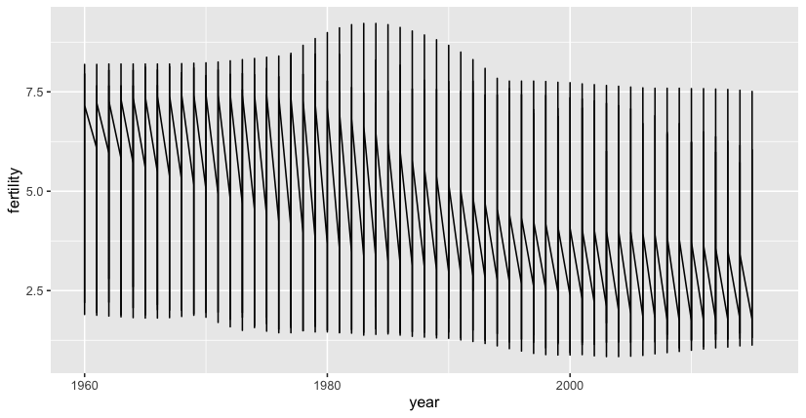
Fertility over Time
ggplot(data = gapminder, mapping=aes(x=year, y=fertility)) +
geom_line()
Well, this doesn’t look right. What happened?

Slide 27
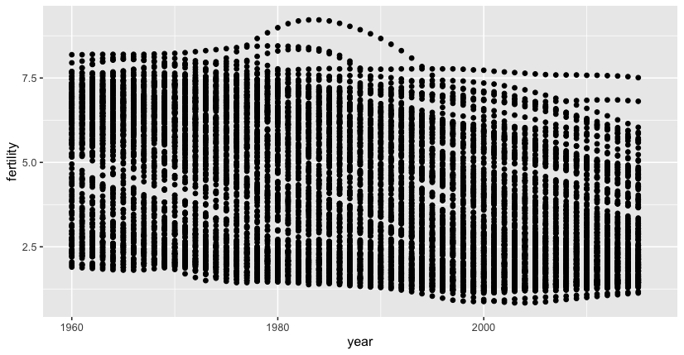
Fertility over Time (scatter plot)
ggplot(data = gapminder, mapping=aes(x=year, y=fertility)) +
geom_point()
Displaying the data as a scatter plot can help us figure out what’s going on
There are many values of fertility for each year (one for each country)
It doesn’t make sense to draw a single line through all these points

Slide 28
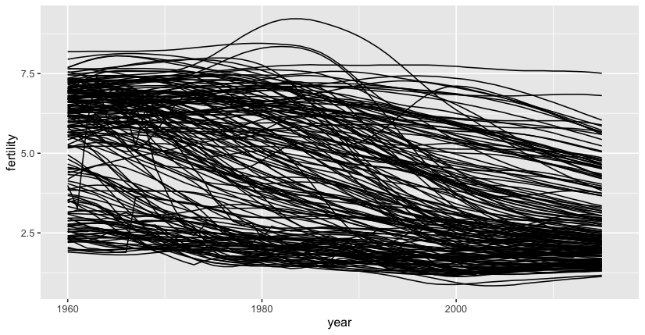
Fertility over Time (line for each country)
ggplot(data = gapminder, mapping=aes(x=year, y=fertility)) +
geom_line(aes(group=country))
We need to tell ggplot to create a line for each country using the group argument
Ok, but too many countries!

Slide 29
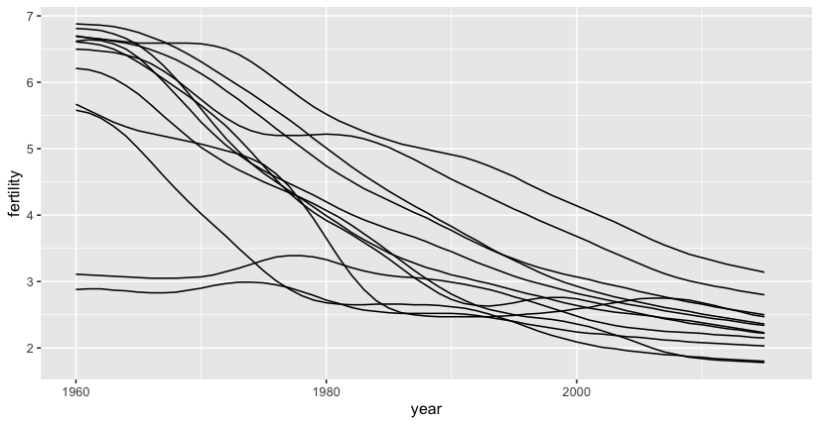
Fertility over Time (line for each country)
First, only select countries in South America, then ggplot
South_America <- gapminder %>%
filter(region=="South America")
ggplot(data = South_America, mapping=aes(x=year, y=fertility)) +
geom_line(aes(group=country))
https://pollev.com/vsovero

Slide 30
Fertility over Time (line for each country)
We can use pipes to wrangle and ggplot all at once
gapminder %>%
filter(region=="South America") %>%
ggplot(mapping=aes(x=year, y=fertility)) +
geom_line(aes(group=country))

Slide 31
Exercise: line graphs
Create a line graph of occupations in architecture and engineering occupations showing percent_female by year
https://pollev.com/vsovero

Slide 32
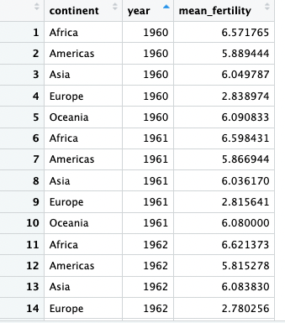
Fertility over Time (line for each continent)
continent_summary<-gapminder %>%
group_by(continent, year) %>%
summarize(mean_fertility=mean(fertility, na.rm=TRUE)
We need to collapse the data to continent by year using group_by() and summarize()

Slide 33
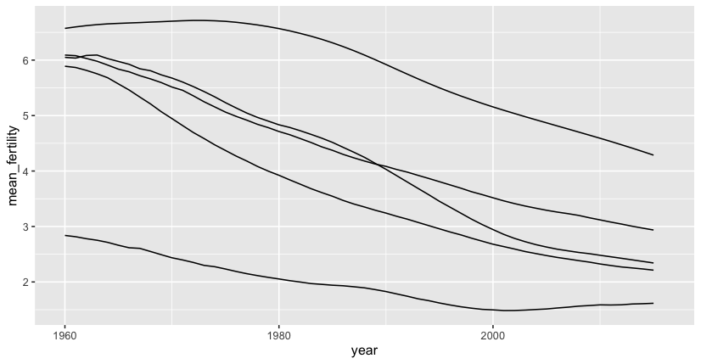
Fertility over Time (line for each continent)
ggplot(data=continent_summary,
mapping=aes(x=year, y=mean_fertility)) +
geom_line(aes(group=continent))
Then we ggplot using the group argument

Slide 34
Exercise
calculate the mean percent_female by year and by minor_category for occupations in computer, engineering and science
plot as a line graph

Slide 35
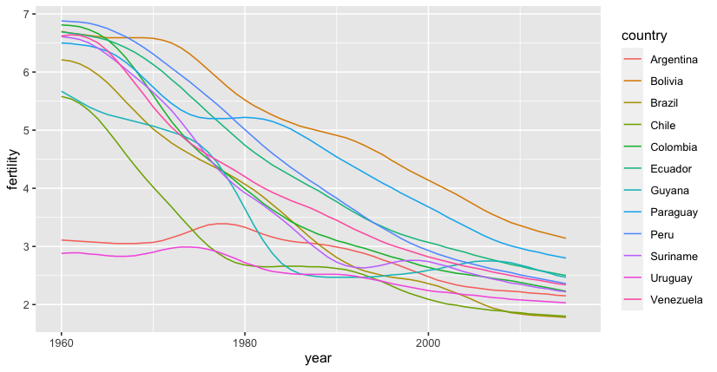
Color Mapping
gapminder %>%
filter(region=="South America") %>%
ggplot(mapping=aes(x=year, y=fertility)) +
geom_line(aes(group=country))
gapminder %>%
filter(region=="South America") %>%
ggplot(mapping=aes(x=year, y=fertility)) +
geom_line(aes(color=country))

Slide 36
Exercise
calculate the mean percent_female by year and by minor_category for occupations in computer, engineering and science
plot as a line graph
color the lines by minor_category
https://pollev.com/vsovero

